Slide 1
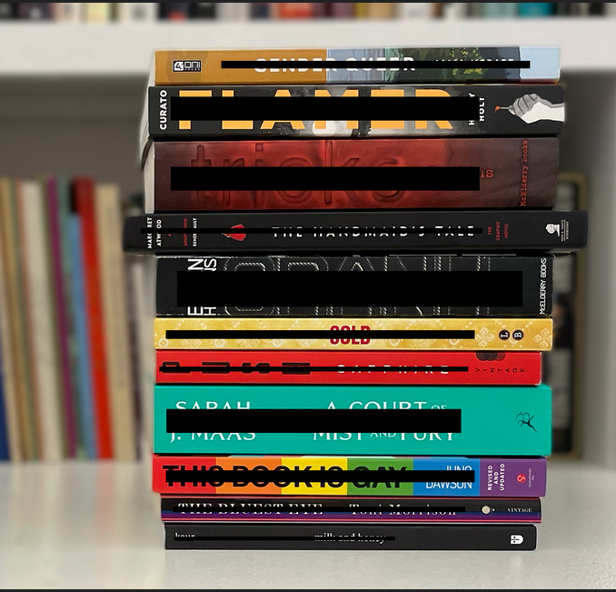
Predicting book bans with topic modelling and logistic regression
Shirley Li, November 2023
Picture from PEN America:
https://pen.org/wp-content/uploads/2023/04/Option-02%E2%80%94v2.png

Slide 2
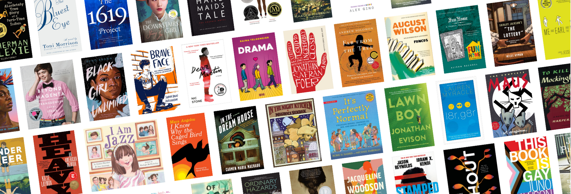
Introduction
Over July 1, 2021 to June 30, 2022, PEN America recorded 2531 book bans of 1656 unique books in schools across America. According to PEN America, popular themes for censorship are race, history, and gender and sexuality.

Slide 3
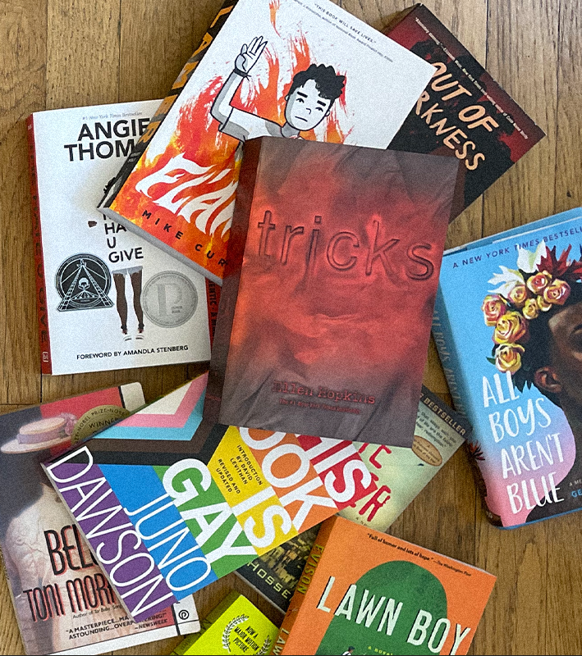
OUR TASK
Let's build a model that will predict whether a book will be banned, and what themes (”features”) are relevant.
Image from PEN America: https://pen.org/wp-content/uploads/2023/09/Banned-in-the-USA-Hero-Image-Option_V3.png

Slide 4
Data
Banned Books
Non-Banned Books
Using BeautifulSoup, I scraped my non-banned books from a private blog, Library of 1000 Books. I checked for overlap with the PEN America list and removed duplicates.
I sourced my banned books from PEN America (spreadsheet here). These book bans occurred from July 1, 2021 - June 30, 2022.
Book Descriptions
Using the Google Books API, I pulled Book Descriptions for both spreadsheets (banned and well-known books). I was not able to pull descriptions for all books.
Final Dataset
After cleaning, I was left with a total of 1477 books, 938 of which were banned and 539 of which were not banned.

Slide 5







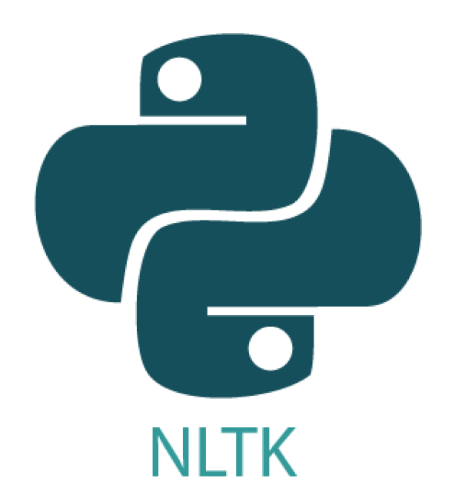

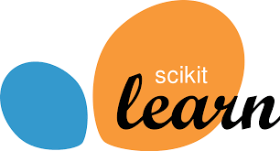
Tools used
Numpy and pandas for data wrangling
requests and BeautifulSoup for web scraping
Google Books API for obtaining book descriptions
matplotlib, seaborn, and Scattertext for data visualization and analysis
NLTK and spacy for NLP analysis (stopwords, tokenization, lemmatization, and more)
CountVectorizer and TFIDF for vectorizing words in book descriptions
TruncatedSVD and NMF for topic modelling
sklearn for modelling and evaluation

Slide 6
Data Wrangling and EDA
I cleaned my data (”Book Descriptions”) using various NLP techniques:
removed stopwords
removed all words except nouns and adjectives
lemmatized words
removed descriptions with too few words & truncated descriptions with too many
and more.
I used Scattertext to create a visualization of nouns and adjectives appearing in the descriptions of banned and non-banned books (see next slide)…

Slide 7
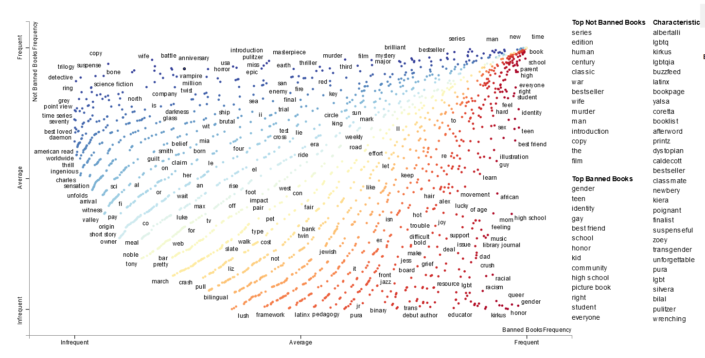
scattertext: frequent nouns & Adjectives

Slide 8
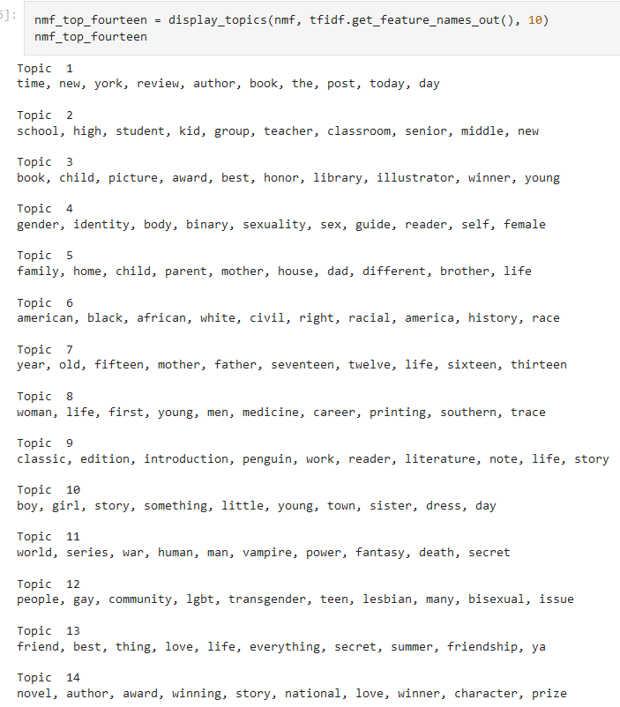
Topic modelling: TFIDF and nmf
1. “nyt_author”
2. “middle_and_high_school”
3. “award_winning_childrens”
4. “gender_and_sexuality”
5. “families_and_home”
6. “race_and_america”
7. “growing_up”
8. “young_woman_meets_man”
9. “classics”
10. “boy_girl_story”
11. “book_series”
12. “lgbtq_sexuality”
13. “friendship”
14. “prize_novel”

Slide 9
Modelling
 | Dummy | Logistic Regression | KNN | Decision Tree | Random Forest
Training Accuracy | 0.64 | 0.80 | 0.78 | 0.74 | 1.0
Test Accuracy | 0.63 | 0.78 | 0.80 | 0.72 | 0.76

Slide 10
Final Model: logistic regression
Test Metrics
Accuracy: 0.78
Parameters
penalty: l2
Precision: 0.87
Recall: 0.77
F1-Score: 0.82
ROC-AUC: 0.85
C: 0.1
solver: lbfgs
class_weights: balanced

Slide 11
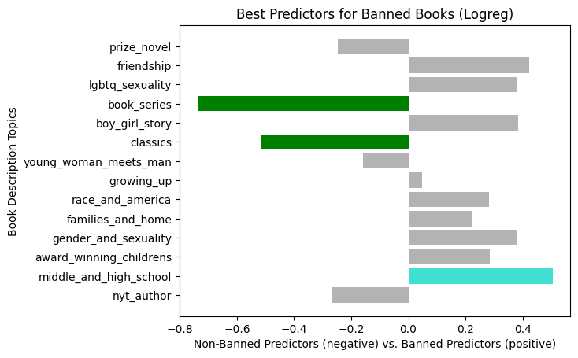
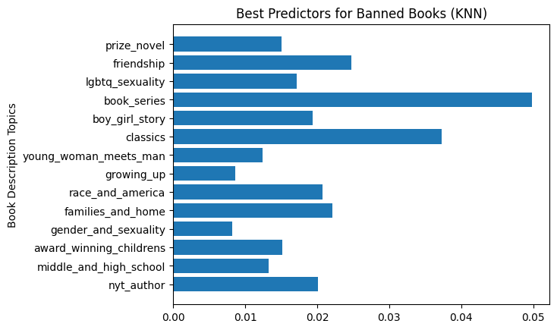
Best predictors for banned books

Slide 12
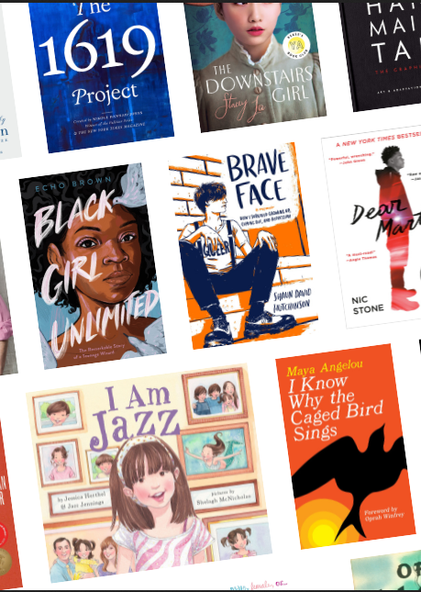
Future steps
Scrape more data (non-banned books), especially from school-age libraries
Systematize topic modelling
Increase accuracy to 80%
Explore mislabelled books in the test set – why were they mislabelled?

